Slide 1
BME 790 Spring 2017 Weekly Summary
Author: Daniel A Hagen
Week: 02/27/17-03/05/17 Relevant Topics: Gaits, non-communitive and non-conservative effects, Lie bracket, curl and Stokes Theorem

Slide 2
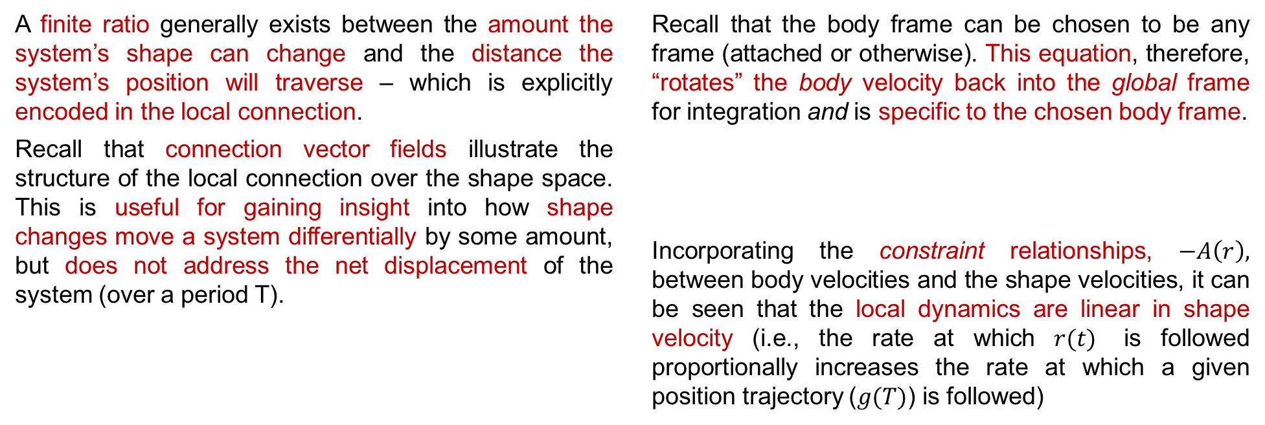
Gaits
“[The] ability to effectively locomote over long distances [is] rooted in local dynamics – if you can’t move over short distances, you can’t move over long distances.”¹
A finite ratio generally exists between the amount the system’s shape can change and the distance the system’s position will traverse – which is explicitly encoded in the local connection.
Recall that connection vector fields illustrate the structure of the local connection over the shape space. This is useful for gaining insight into how shape changes move a system differentially by some amount, but does not address the net displacement of the system (over a period T).
Recall that the body frame can be chosen to be any frame (attached or otherwise). This equation, therefore, “rotates” the body velocity back into the global frame for integration and is specific to the chosen body frame.
Incorporating the constraint relationships, $−A\left(r\right),$ between body velocities and the shape velocities, it can be seen that the local dynamics are linear in shape velocity (i.e., the rate at which $r(t)$ is followed proportionally increases the rate at which a given position trajectory ($g(T)$) is followed)
¹ An Introduction to Geometric Mechanics and Differential Geometry by Ross L Hatton and Howie Choset

Slide 3


Gaits
This time integral can be rewritten as a line integral over the shape space where the time scaling of the motion drops out.
Thus, the displacement is solely a function of the path a system takes through shape space and is independent of the pacing with which it is followed.
Consider “Elroy’s Extensible Beanie” with the local connection listen above. The position variable is the overall orientation of the bottom disc ($θ$) while the angle with which the top bar is rotated ($α$) and the length of the extensible arms ($δ$) are the shape parameters. This model will be referenced in future slides to discuss displacement.
But then how do we find a shape space trajectory ($r(t)$) that results in a desired system position trajectory ($g(t)$)?

Slide 4

Constraint Curvature
To find the net displacement over a cycle (steps 1-5), it is not necessary to explicitly calculate the intermediate displacements (e.g., 1 to 2, 2 to 3, etc.) but instead measure the “failure” to cancel each displacement out corresponding to a change in the system dynamics.
The change in the system dynamics is measured by the curvature of the system encoded in the local connection. This curvature is referred to as the constraint curvature as it is the derivative of the local connection (which was derived from constraints $ω\left(q\right)$).
The curvature has two components:
Non-conservative part
Contains the change in the local connection across the shape space
Non-commutative part
Contains the effects of A (and therefore the entire system) being defined w.r.t. a moving body frame.

Slide 5
Non-Conservative Effects
From the shape trajectory above (green), it can be seen that the displacement from 1 to 2 is not canceled out by the displacement from 3 to 4, which causes an overall displacement. This is brought on by fact that the connection vector field is not conservative.
Recall that if a vector field is conservative, the curl of that vector field is equal to zero. Additionally, the work done by a system that travels around a closed path is also zero.
Therefore, when a connection vector field is not conservative, the net work on the system and the curl will be non-zero brought on by a change in the system dynamics over a (closed) gait cycle.
Note that only some changes in the connection vector field result in changes in the system dynamics. Only changes in the vector fields along directions orthogonal to that component produce these changes. Additionally, it is possible for changes in one component to cancel out the changes in another. But generally, the change in the local connection vector field over the shape space allows for net displacement across gaits.

Slide 6
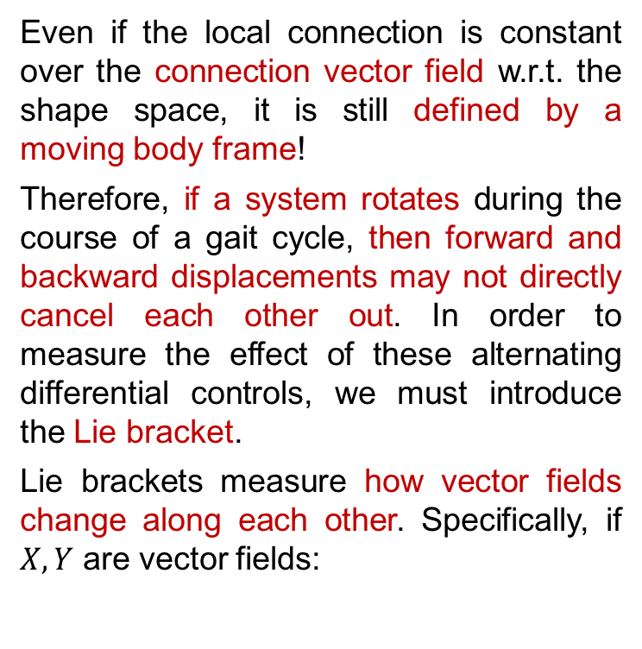
Non-Commutative Effects
Even if the local connection is constant over the connection vector field w.r.t. the shape space, it is still defined by a moving body frame!
Therefore, if a system rotates during the course of a gait cycle, then forward and backward displacements may not directly cancel each other out. In order to measure the effect of these alternating differential controls, we must introduce the Lie bracket.
Lie brackets measure how vector fields change along each other. Specifically, if $X,Y$ are vector fields:
Recall, that for the differential drive example, that velocity in the y-direction was restricted by the Pfaffian. The distribution of allowable vectors (i.e., the null space of the Pfaffian) is spanned by:

Slide 7

Non-Commutative Effects (Cont.)
When dealing with Lie groups, the Lie bracket takes on an additional feature.
Specifically, this means that any two vectors in the tangent space at the origin – which by definition, all body velocities are – have a Lie bracket equal to that of the corresponding position velocities evaluated at the identity element (recall, $T_{e}L_{g}ξ=\dot{g}$). For the differential drive example:
This differential motion produces a net y-direction velocity, previously prohibited by the Pfaffian constraints.

Slide 8
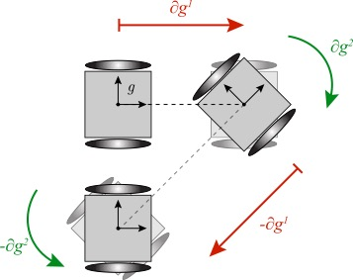





Displacement Approximation
The approximation of the net displacement then takes into account both the displacement caused by the change in connection vector fields (using Stokes thm to calculate the line integral as the area of the region encircled in the vector (height) function) and the movement caused by the choice of (moving) body frame.
More generally for SE(2) this property takes the form:
This is referred to as Lie Bracket averaging – if you alternate between moving straight back/forth and rotating back/forth, on average you will move laterally.
*Equations above taken from Choset’s .ppt presentations on the subject, available through https://sites.google.com/site/16742geometryoflocomotion/course-notes

Slide 9
Conclusions/Impressions
The choice of body frame plays a large role in finding net displacements after a given “gait cycle”. If we choose our body frame appropriately (or optimally) we may find better approximations of net displacements by finding local connections that do not drastically change with shape values (the more variable the local connection, the less accurate the approximation as these techniques utilize the linearizations for the tangent space at the origin, i.e., the Lie algebra.)
Additionally, any movement in the chosen body frame can be accounted for by the use of the Lie bracket. Further reading on this subject will focus on body frame optimization that utilizes these principles to find accurate representations of movements given the constraint curvature.
References:
Choset, H. and Hatton, RL, 2015. An Introduction to Geometric Mechanics and Differential Geometry
Online Materials available at: https://sites.google.com/site/16742geometryoflocomotion/home

